Slide 1
Classification and Prediction
Classification Accuracy

Slide 2
Classification and Prediction
Basic Concepts
Issues Regarding Classification and Prediction
Decision Tree
Bayesian Classification
Neural Networks
Support Vector Machine
Associative classification
Classification Accuracy

Slide 3
Classification Accuracy: Estimating Error Rates
Test set测试集
Precision (准确率) and Recall (召回率)
  A: sample number which are correctly classified.正确归类的样本数
  B: sample number which are classified.分类的样本数
  C: sample number in test set测试集的样本数
Precision准确率=A/B
Recall召回率=A/C

Slide 4
Classification Accuracy: Estimating Error Rates
分区:训练和测试
  用两个独立的数据集，例如，训练集 (2/3),训练集(1/3)
  used for data set with large number of samples用于有大量样本数的数据集
Cross-validation交叉验证
  divide the data set into k subsamples将数据集分成k个子样本
  use k-1 subsamples as training data and one sub-sample as test data—k-fold cross-validation用k-1 个子样本作为训练数据，一个字样本作为测试数据——K-fold交叉验证
  for data set with moderate size用于中等规模的数据集

Slide 5
Bagging and Boosting
大意 ：抽样
Training data训练数据
Altered Training data 改变的训练数据
Altered Training data改变的训练数据
……..
Aggregation聚合 ….
分类方法Classification method (CM)
Classifier C
CM
Classifier C1
CM
Classifier C2
Classifier C*

Slide 6
Bagging
给定一个样本的集合S
从S生成一个引导程序样本T。S中的案例可能不会在T中出现，或可能在T中不止出现一次。
重复此抽样程序，得到k个独立训练集序列
用同样的分类算法，对于每一个这样的训练集， 构建分类器C1,C2,…,Ck 的一个对应的序列
让每个分类器预测或投票，对一个未知的样本X分类
The Bagged Classifier C* counts the votes and assigns X to the class with the “most” votes袋装分类器对投票计数并且指定最多投票的为类别X

Slide 7
Boosting Technique — Algorithm
给每个例子指定一个相同的权重 1/N
For t = 1, 2, …, T Do
  Obtain a hypothesis (classifier) h^{(t)} under w^{(t)}
  计算h(t)的错误并在此基础上重新给予例子权重。每个分类器都依赖于前一个。预测不准确的样本有更高的权重。
  标准化w^{(t+1)} 使和为1 (指定个不同分类器的权重的和为1)
输出所有假设的权重和，每个假设的权重是根据它在训练集的准确度

Slide 8
Boosting Technique — Algorithm
k, the number of classifiers
Di, the ith training set sampling from S,
Mi, the classifier of ith model corresponding to Di
n, the number of the samples in each Di
Boosting Algorithm:
1 for i=1 to k
2 construct Di;
3 initialize weights of each sample(1/n);
4 construct Mi using Di;
5 evaluate classifier err(Mi);(if err(Mi)>threshold, then go to 2)
6 update the weight of each sample;
7 endfor
8 calculate the weight for each classifier Mi

Slide 9
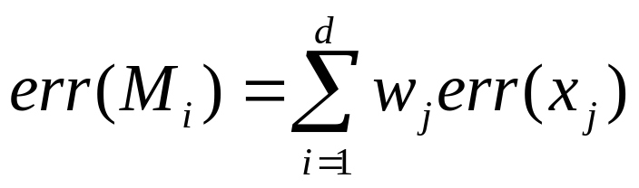
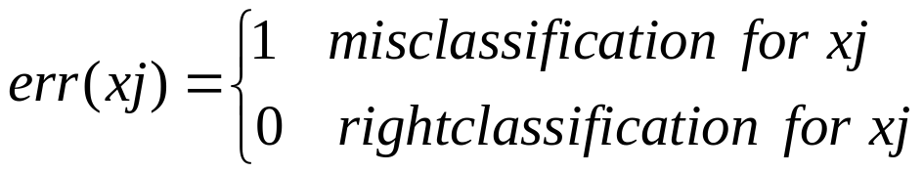
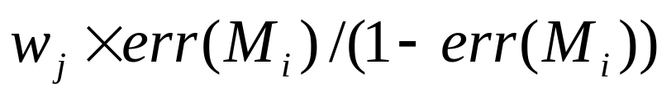
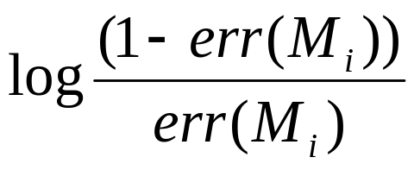
Boosting Technique — Algorithm
构建 Di
  Sampling with the replacement strategy替换策略抽样
评估错误(Mi)
更新样本权重x_{j}
Calculate the weights of k classifiers技术k分类器的权重

Slide 10
Summary
分类是一个被广泛研究的问题(主要在统计，机器学习&神经网络)
Classification is probably one of the most widely used data mining techniques with a lot of extensions分类可能是用的最广泛的数据挖掘技术
对于数据库应用，可扩展性依然是一个重要的问题:因此，将分类和数据库技术结合应该是一个有前景的主题
研究方向:不相关数据分类，例如，文本，空间，多媒体，等

